Slide 1
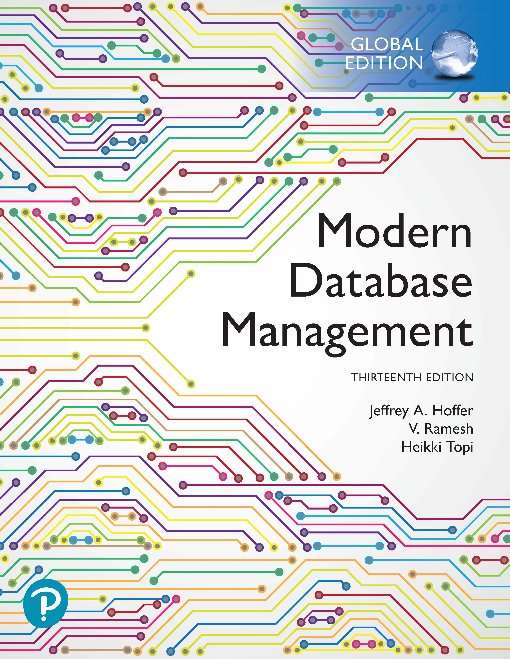
Modern Database Management
Thirteenth Edition, Global Edition
Chapter 5
Introduction to S Q L
Copyright © 2020 Pearson Education Ltd. All Rights Reserved
Notes:
If this PowerPoint presentation contains mathematical equations, you may need to check that your computer has the following installed:
1) MathType Plugin
2) Math Player (free versions available)
3) NVDA Reader (free versions available)

Slide 2
Learning Objectives
5.1 Define terms
5.2 Interpret the history and role of S Q L in database development
5.3 Define a database using the S Q L data definition language
5.4 Write single-table queries using S Q L commands
5.5 Establish referential integrity using S Q L
5.6 Discuss the S Q L:1999 and S Q L:2016 standards

Slide 3
S Q L Overview
Structured Query Language – often pronounced “Sequel”
The standard for Relational Database Management Systems (R D B M S)
R D B M S: A database management system that manages data as a collection of tables in which all relationships are represented by common values in related tables

Slide 4
History of S Q L
1970 – E. F. Codd develops relational database concept
1974-79 – System R with Sequel (later S Q L) created at I B M Research Lab
1979 – Oracle markets first relational D B with S Q L
1981 – S Q L/D S first available R D B M S system on D O S/V S E
Others followed: I N G R E S (1981), I D M (1982), D G/S G L (1984), Sybase (1986)
1986 – ANSI S Q L standard released
Major ANSI standard updates in 1989, 1992, 1999, 2003, 2006, 2008, 2011, 2016
Today – S Q L is supported by most major database vendors
Is S Q L a standard? No longer certified by N I S T.
Notes:
The concepts of relational database technology were first articulated in 1970 in E. F. Codd’s classic paper “A Relational Model of Data for Large Shared Data Banks.” System R was a project at the IBM Research Laboratory in San Jose, California, that demonstrated the feasibility of implementing the relational model in a database management system. They used a language they called “sequel”. It’s later been named SQL, but “sequel” is still often how it is pronounced.
SQL-92 was a major revision and was structured into three levels: Entry, Intermediate, and Full. SQL:1999 established the core-level conformance, which must be met before any other level of conformance can be achieved; core-level conformance requirements were unchanged in SQL:2011. In addition to fixes and enhancements of SQL:1999, SQL:2003 introduced a new set of SQL/XML standards, three new data types, various new built-in functions, and improved methods for generating values automatically. SQL:2006 refined these additions and made them more compatible with XQuery, the XML query language published by the World Wide Web Consortium (W3C). SQL:2008 improved analytics, query capabilities, and exchanged MERGE for combining tables. The most important new additions to SQL:2011 were related to temporal databases, that is, databases that are able to capture the change in data values over time. At the time of this writing, most database management systems claim SQL-92 compliance and partial compliance with SQL:1999 and SQL:2011. SQL:2016 added row pattern recognition, JSON support, polymorphic table functions, and an extended set of analytic capabilities.
Is SQL a standard? It is no longer certified by the U.S. Department of Commerce’s National Institute of Standards and Technology (NIST).

Slide 5
Original Purpose of S Q L Standard
Specify syntax/semantics for data definition and manipulation
Define data structures and basic operations
Enable portability of database definition and application modules
Specify minimal (level 1) and complete (level 2) standards
Allow for later growth/enhancement to standard (referential integrity, transaction management, user-defined functions, extended join operations, national character sets)
Notes:
Is SQL a standard? No longer certified by the U.S. Department of Commerce’s National Institute of Standards and Technology (NIST).

Slide 6
Benefits of a Standardized Relational Language
Reduced training costs
Productivity
Application portability
Application longevity
Reduced dependence on a single vendor
Cross-system communication
Notes:
These are all benefits of standardization. Keep in mind, though, that different database vendors may use different constructs in their SQL versions, so the standards are not perfectly applied.
Standards are good, but they also have disadvantages. A standard can stifle creativity and innovation. One standard is never enough to meet all needs, and an industry standard can be far from ideal because it may be the offspring of compromises among many parties. The standard may be difficult to change (because so many vendors have a vested interest in it), so fixing deficiencies may take considerable effort. Since vendors typically extend standards with proprietary features, application portability isn’t complete; you may need to change SQL statements when migrating from one vendor to another (for example, switching from Oracle to Microsoft SSL Server or vice versa).

Slide 7
S Q L Environment
Catalog
A set of schemas that constitute the description of a database
Schema
The structure that contains descriptions of objects created by a user (base tables, views, constraints)
Data Definition Language (D D L)
Commands that define a database, including creating, altering, and dropping tables and establishing constraints
Data Manipulation Language (D M L)
Commands that maintain and query a database
Data Control Language (D C L)
Commands that control a database, including administering privileges and committing data

Slide 8
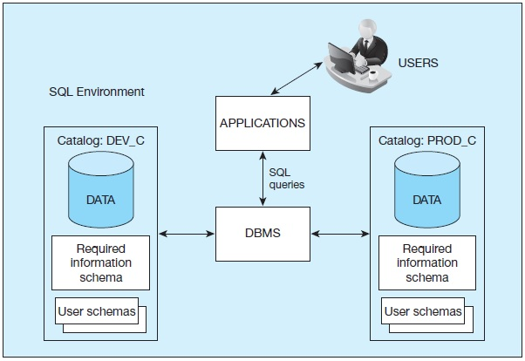
Figure 5-1 S Q L Environment, as Described by the S Q L:2016 Standard
Notes:
A database instance, also called a database server, is a set of memory structure and software processes that manage the access to a set of database files. Each instance maintains one or more databases, organized into catalogs consisting of schemas.
Here we see an instance of a DBMS along with two databases (PROD and DEV). The Production database contains its own data indexed by the catalog PROD_C. It is the actual database being used for business operations. The Development database is used for making application changes and testing. Usually, organizations have two separate databases, one for production and one for development.

Slide 9
SQL Data Types
Strings
CHARACTER (n), VARYING CHARACTER (n)
Binary
Binary Large Object (B L O B)
Number
Numeric (precision, scale), Decimal (p, s), Integer
Temporal
Timestamp, Timestamp with local time zone
Boolean
True or False values

Slide 10
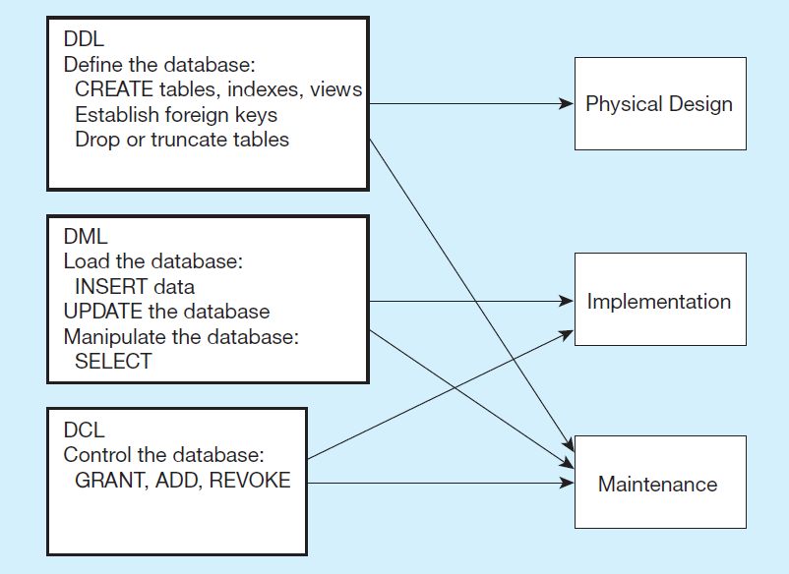
Figure 5-4 D D L, D M L, D C L, and the Database Development Process
Notes:
SQL is composed of three sub-languages, DDL, DML, and DCL.
DDL is Data Definition Language. This is used to actually create the metadata of the database, including all tables, attributes and their data types, indexes, primary and foreign keys, etc. The DDL implements the logical design into actual physical databases. This is the language that database designers will use to create the database.
DML is Data Manipulation Language. This includes all query, update, insert, and delete statements. This is the language that allows users and applications to interact with and manipulate the data in the database.
DCL is Data Control Language. This is used by database administrators to specify who can access the data, and the types of data and operations these users are authorized to manipulate.

Slide 11
S Q L Database Definition
Data Definition Language (D D L)
Major CREATE statements:
CREATE SCHEMA – defines a portion of the database owned by a particular user
CREATE TABLE – defines a new table and its columns
CREATE VIEW – defines a logical table from one or more tables or views
Other CREATE statements: CHARACTER SET, COLLATION, TRANSLATION, ASSERTION, DOMAIN

Slide 12
Steps in Table Creation
Identify data types for attributes
Identify columns that can and cannot be null
Identify columns that must be unique (candidate keys)
Identify primary key–foreign key mates
Determine default values
Identify constraints on columns (domain specifications)
Create the table and associated indexes

Slide 13
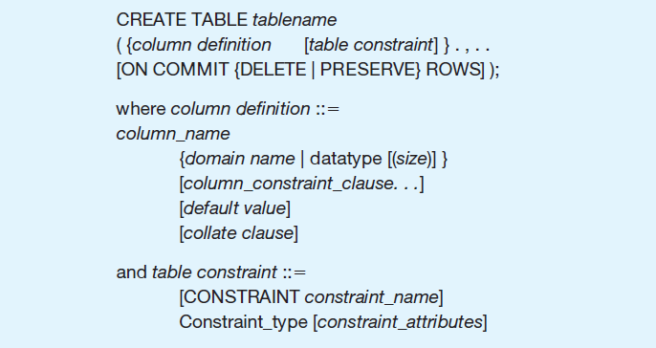
Figure 5-5 General Syntax for CREATE TABLE Statement Used in Data Definition Language
Notes:
This figure shows the overall structure of a CREATE TABLE statement. It shows that the table will have a name, and some number of column definitions and table constraints. In the following slides, we see several examples, related to the Pine Valley Furniture database.

Slide 14
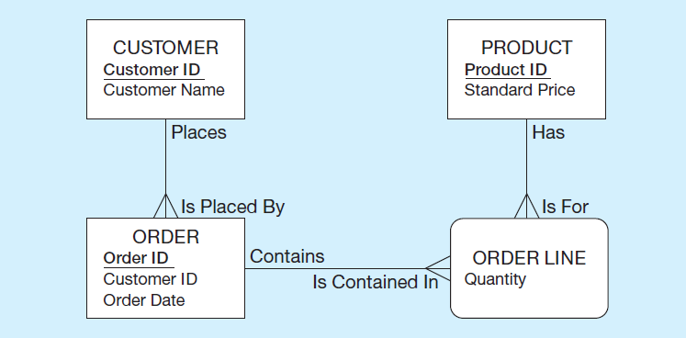
The Following Slides Create Tables for This Enterprise Data Model
(from Chapter 1, Figure 1-3)
Notes:
This is the E-R diagram from chapter 1. Each of these entities, including the associative entity, is implemented as a table in the database.

Slide 15
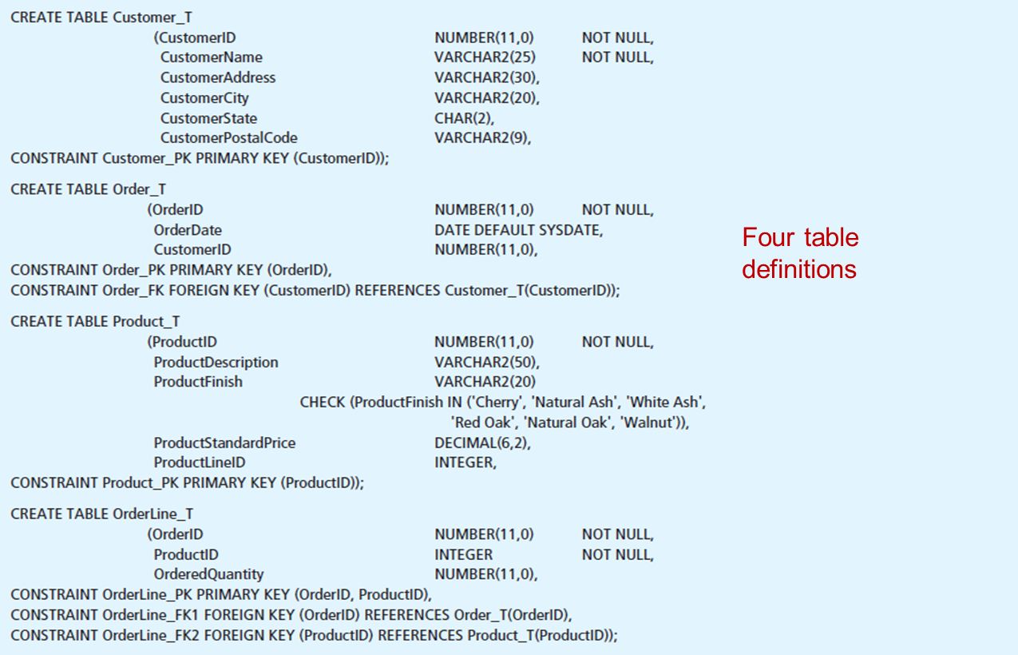
Figure 5-6 S Q L Database Definition Commands for P V F Company (Oracle 12c)
Notes:
Here we see the SQL DDL commands for creating four tables, one each for customer, order, product, and order line. Note that for each of these, there is some number of column definitions and some number of constraints.
Steps to follow when preparing to create a table:
1. Identify the appropriate data type, including length, precision, and scale, if required, for each attribute.
2. Identify the columns that should not accept null values. Column controls that indicate a column cannot be null are established when a table is created and are
enforced for every update of the table when data are entered.
3. Identify the columns that need to be unique. When a column control of UNIQUE is established for a column, the data in that column must have a different value for each row of data within that table (i.e., no duplicate values). Where a column or set of columns is designated as UNIQUE, that column or set of columns is a candidate key, as discussed in Chapter 4. Although each base table may have multiple candidate keys, only one candidate key may be designated as a PRIMARY KEY. When a column(s) is specified as the PRIMARY KEY, that column(s) is also assumed to be NOT NULL, even if NOT NULL is not explicitly stated. UNIQUE and PRIMARY KEY are both column constraints. Note that a table with a composite primary key, OrderLine_T, is defined in Figure 5-6. The OrderLine_PK constraint includes both OrderID and ProductID in the primary key constraint, thus creating a composite key. Additional attributes may be included within the parentheses as needed to create the composite key.
4. Identify all primary key–foreign key connections, as presented in Chapter 4. Foreign keys can be established immediately, as a table is created, or later by altering the table. The parent table in such a parent–child relationship should be created first so that the child table will reference an existing parent table when it is created. The column constraint REFERENCES can be used to enforce referential integrity (e.g., the Order_FK constraint on the Order_T table).
5. Determine values to be inserted in any columns for which a default value is desired. DEFAULT can be used to define a value that is automatically inserted when no value is identified during data entry. In Figure 5-6, the command that creates the Order_T table has defined a default value of SYSDATE (Oracle’s name for the current date) for the OrderDate attribute.
6. Identify any columns for which domain specifications may be stated that are more constrained than those established by data type. Using CHECK as a column constraint, it may be possible to establish validation rules for values to be inserted into the database. In Figure 5-6, creation of the Product_T table includes a check constraint, which lists the possible values for ProductFinish. Thus, even though an entry of ‘White Maple’ would meet the VARCHAR2 data type constraints, it would be rejected because ‘White Maple’ is not in the checklist.
CREATE TABLE statements from Figure 5-6:
CREATE TABLE Customer_T
(CustomerID NUMBER(11,0)
CustomerName VARCHAR2(25)
CustomerAddress VARCHAR2(30),
CustomerCity VARCHAR2(20),
CustomerState CHAR(2),
CustomerPostalCode VARCHAR2(9),
CONSTRAINT Customer_PK PRIMARY KEY (CustomerID));
CREATE TABLE Order_T
(OrderID NUMBER(11,0) NOT NULL,
NOT NULL,
NOT NULL,
OrderDate DATE DEFAULT SYSDATE,
CustomerID NUMBER(11,0),
CONSTRAINT Order_PK PRIMARY KEY (OrderID),
CONSTRAINT Order_FK FOREIGN KEY (CustomerID) REFERENCES Customer_T(CustomerID));
CREATE TABLE Product_T
(ProductID NUMBER(11,0) NOT NULL,
ProductDescription VARCHAR2(50),
ProductFinish VARCHAR2(20)
CHECK (ProductFinish IN ('Cherry', 'Natural Ash', 'White Ash',
'Red Oak', 'Natural Oak', 'Walnut')),
ProductStandardPrice DECIMAL(6,2),
ProductLineID INTEGER,
CONSTRAINT Product_PK PRIMARY KEY (ProductID));
CREATE TABLE OrderLine_T
(OrderID NUMBER(11,0) NOT NULL,
ProductID INTEGER NOT NULL,
OrderedQuantity NUMBER(11,0),
CONSTRAINT OrderLine_PK PRIMARY KEY (OrderID, ProductID),
CONSTRAINT OrderLine_FK1 FOREIGN KEY (OrderID) REFERENCES Order_T(OrderID),
CONSTRAINT OrderLine_FK2 FOREIGN KEY (ProductID) REFERENCES Product_T(ProductID));

Slide 16
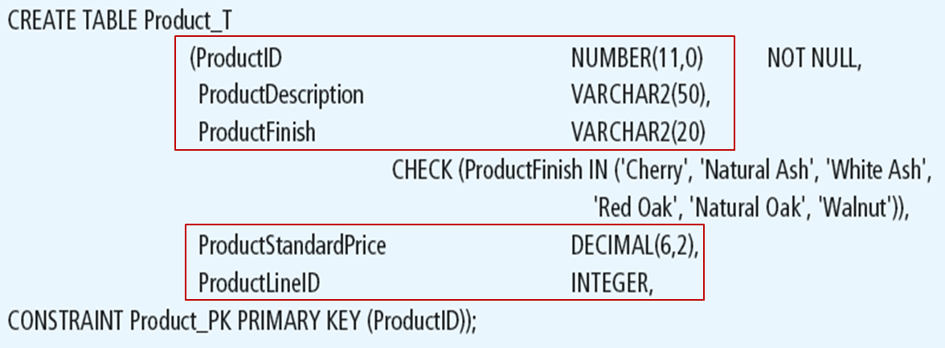
Defining Attributes and Their Data Types
Notes:
Each column has a data type. In this case, some are numeric, and some are character (text). You can also specify column sizes. For numeric columns, you can specify whether they will be integer (which ProductID is) or allow decimal values (such as ProductStandardPrice).

Slide 17
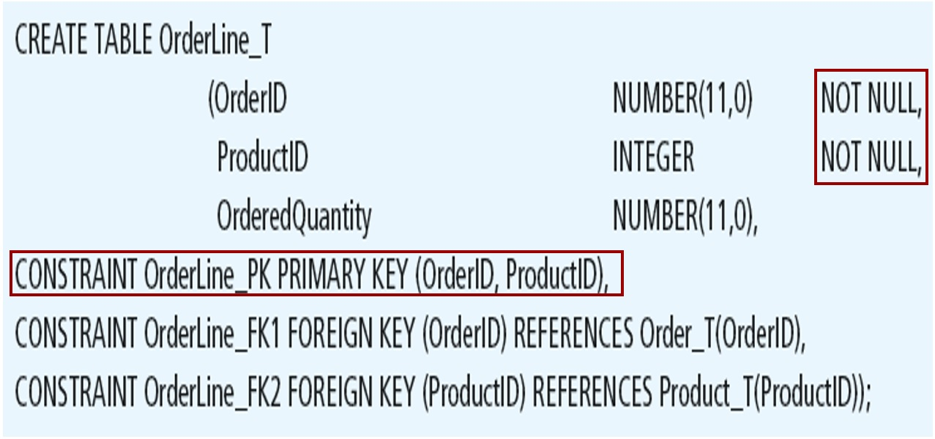
Non-Nullable Specifications
Some primary keys are composite– composed of multiple attributes
Notes:
For this table, we see a composite primary key.
Remember that OrderLine is an associative entity, between Product and Order. Therefore it has two foreign keys, one to each of these tables.

Slide 18
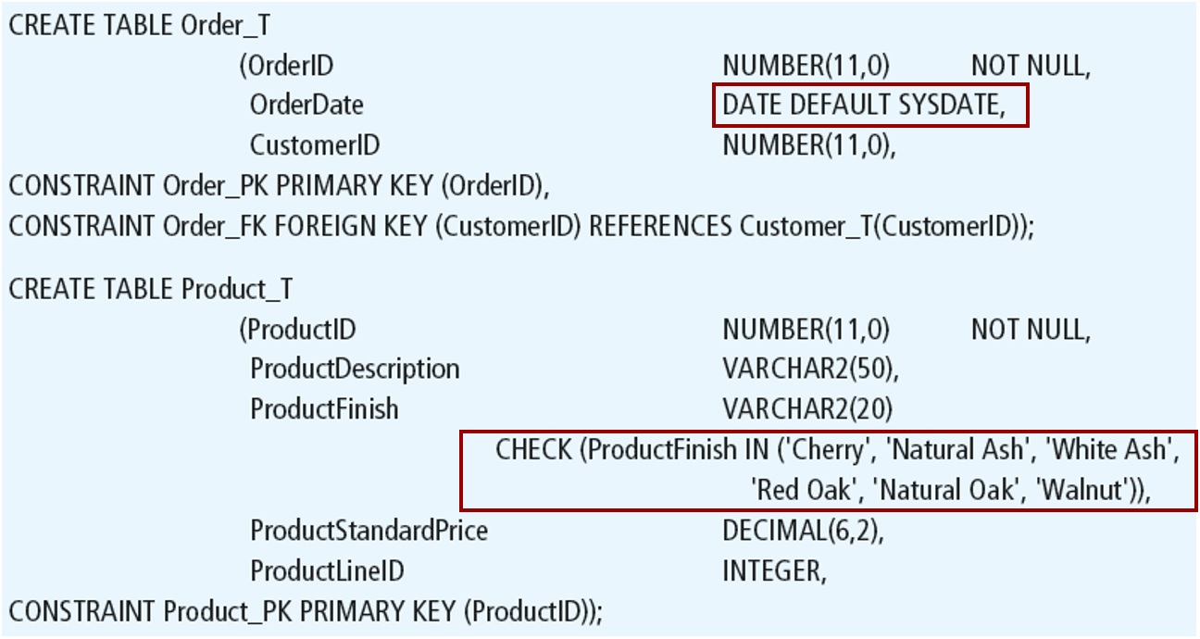
Controlling the Values in Attributes
Notes:
Here we see a domain constraint that limits the number of allowable values for the ProductFinish column. The CHECK operator always ensures that update and insert attempts to this table will only allow the values listed. However, because ProductFinish does not prohibit null values, it is possible to insert a record while leaving ProductFinish without a value at all.
We also see a default value for OrderDate, which is SYSDATE. SYSDATE is the current date. So, if a new order record is created and the order date is not explicitly entered, then it defaults to the current date at the time the record is created (via an INSERT statement).

Slide 19
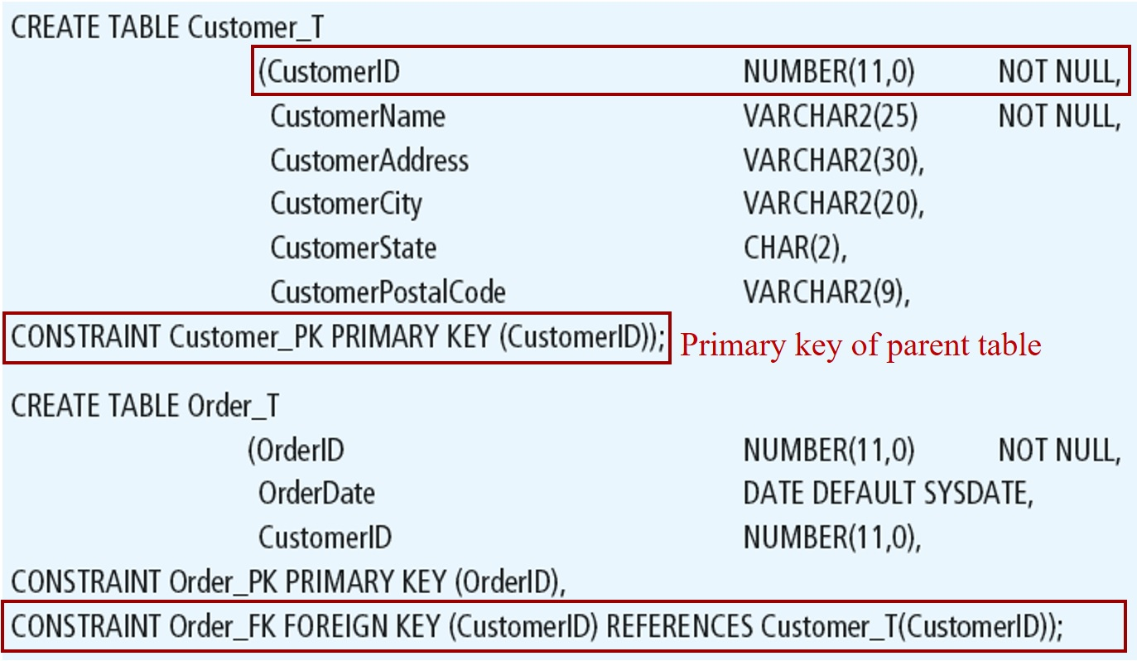
Identifying Foreign Keys and Establishing Relationships
Notes:
Here we see that the Order table has a foreign key. This CONSTRAINT statement creates a foreign key constraint, referencing the Customer table’s primary key.

Slide 20
Data Integrity Controls
Referential integrity – constraint that ensures that foreign key values of a table must match primary key values of a related table in
relationships
Restricting:
Deletes of primary records
Updates of primary records
Inserts of dependent records

Slide 21
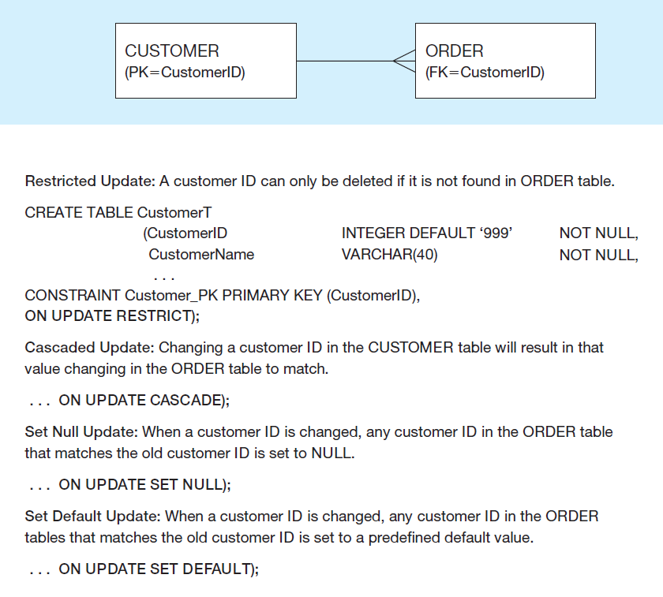
Figure 5-7 Ensuring Data Integrity Through Updates
Relational integrity is enforced via the primary-key to foreign-key match
Notes:
The CREATE TABLE statement includes a clause to specify how updates and deletes are processed when there are dependent tables. If a DELETE request comes for a record with dependent records in another table, the DBMS could restrict the delete, which means to disallow it. Or, it could cascade the delete, so that dependent records with matching foreign keys will also be deleted. Or it could set null, which means that deleting the primary key record will result in setting all corresponding foreign keys to be set to null (this would imply an optional one cardinality in the relationship).

Slide 22

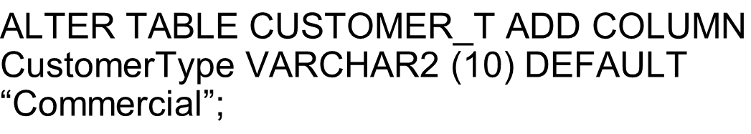
Changing Tables
ALTER TABLE statement allows you to change column specifications:
,
Table Actions:
,
,
Example (adding a new column with a default value):
,
Notes:
The ALTER command will be done after tables have already been created. For example, if you have an existing database, even one with actual data in it, you can modify tables by adding or changing columns, removing columns adding constraints, etc. If data in the tables violate the constraints, you will be prevented from setting these constraints until after changing the data.
So, whereas CREATE TABLE is mostly a process that takes place during implementation, ALTER TABLE often takes place during maintenance.

Slide 23

Removing Tables
DROP TABLE statement allows you to remove tables from your schema:
,
Notes:
Tables will not be dropped if there are other tables that depend on them. This means that if any table has a foreign key to the table being dropped, the drop will fail. Therefore, it makes a difference in which order you drop the tables.

Slide 24
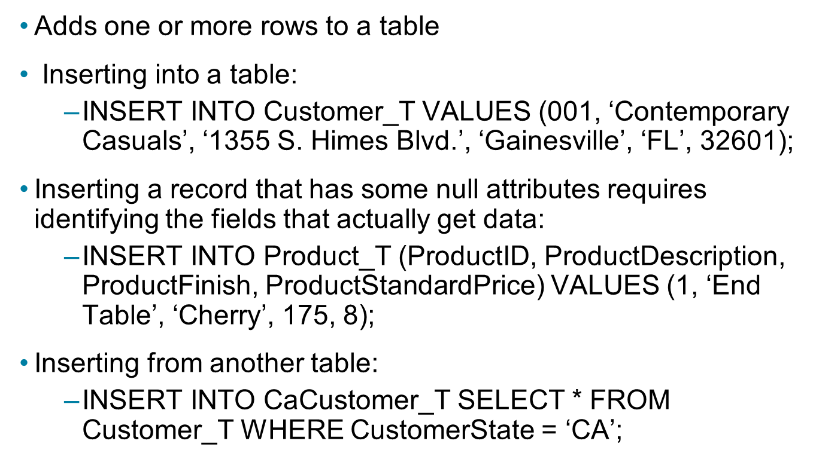
INSERT Statement
Adds one or more rows to a table
Inserting into a table:
,
Inserting a record that has some null attributes requires identifying the fields that actually get data:
,
Inserting from another table:
,
Notes:
As the last statement shows, it is possible to insert data into one table based on a query from another table. We’ll talk more about the SELECT statement shortly.

Slide 25
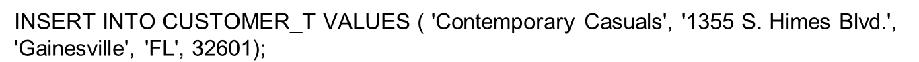
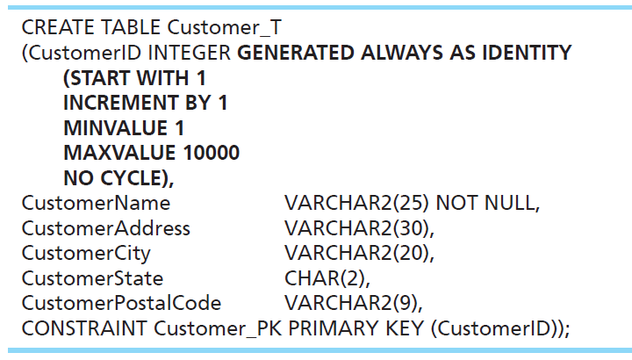
Creating Tables with Identity Columns
Inserting into a table does not require explicit customer I D entry or field list.
Notes:
Identity columns were introduced with SQL:2008. These are columns whose value automatically increment with each new INSERT. So, an INSERT statement does not explicitly give a value for an identity column; this is handled automatically. Often primary keys are identity columns, but not always.
CREATE TABLE Customer_T
(CustomerID INTEGER GENERATED ALWAYS AS IDENTITY
(START WITH 1
INCREMENT BY 1
MINVALUE 1
MAXVALUE 10000
NO CYCLE),
CustomerName VARCHAR2(25) NOT NULL,
CustomerAddress VARCHAR2(30),
CustomerCity VARCHAR2(20),
CustomerState CHAR(2),
CustomerPostalCode VARCHAR2(9),
CONSTRAINT Customer_PK PRIMARY KEY (CustomerID));

Slide 26
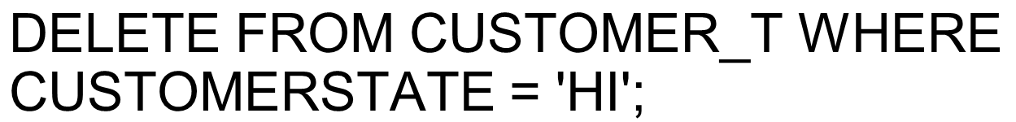

DELETE Statement
Removes rows from a table
Delete certain rows
,
Delete all rows
,
Notes:
Remember, referential integrity rules will control whether a delete actually happens.
The RESTRICT, CASCADE, and SET NULL constraints will determine how to handle the orders for a deleted customer.

Slide 27
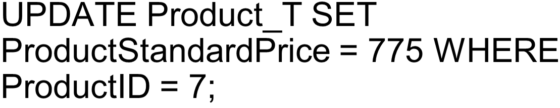
UPDATE Statement
Modifies data in existing rows
Notes:
For this UPDATE, we know that it will affect only one record in the table. How do we know this?
Answer: Because ProductID is the primary key, which must be unique. So, there can be only one product with ProductID = 7.
However, many times updates and deletes affect many records. For example,
DELETE FROM CUSTOMER_T WHERE CUSTOMERSTATE = 'HI'; affects all customers from Hawaii.

Slide 28
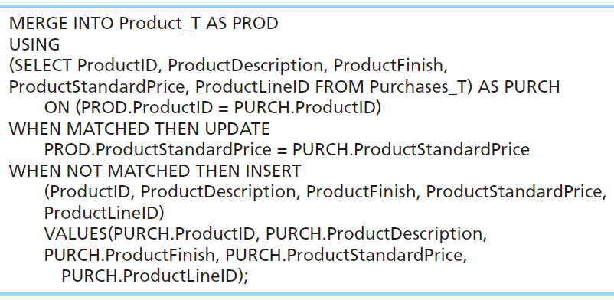
MERGE Statement
Makes it easier to update a table. It allows combination of Insert and Update in one statement.
Useful for updating master tables with new data.
Notes:
The MERGE statement was introduced in SQL:2008 to makes updating a table easier. Many database applications need to update master tables with new data. A Purchases_T table, for example, might include rows with data about new products and rows that change the standard price of existing products. Updating Product_T can be accomplished by using INSERT to add the new products and UPDATE to modify ProductStandardPrice in an SQL:1999 DBMS. SQL:2008 compliant DBMSs can accomplish the update and the insert in one step by using MERGE. The MERGE is based on a query (SELECT), and performs UPDATEs on matched records and INSERTS on unmatched.
MERGE INTO Product_T AS PROD
USING
(SELECT ProductID, ProductDescription, ProductFinish,
ProductStandardPrice, ProductLineID FROM Purchases_T) AS PURCH
ON (PROD.ProductID = PURCH.ProductID)
WHEN MATCHED THEN UPDATE
PROD.ProductStandardPrice = PURCH.ProductStandardPrice
WHEN NOT MATCHED THEN INSERT
(ProductID, ProductDescription, ProductFinish, ProductStandardPrice,
ProductLineID)
VALUES (PURCH.ProductID, PURCH.ProductDescription,
PURCH.ProductFinish, PURCH.ProductStandardPrice,
PURCH.ProductLineID);

Slide 29
Schema Definition
Control processing/storage efficiency:
Choice of indexes
File organizations for base tables
File organizations for indexes
Data clustering
Statistics maintenance
Creating indexes
Speed up random/sequential access to base table data
Example
,
This makes an index for the CUSTOMERNAME field of the
Notes:
All of this has to do with physical database design.

Slide 30
SELECT Statement
Used for queries on single or multiple tables
Clauses of the SELECT statement:
SELECT: List the columns (and expressions) to be returned from the query
FROM: Indicate the table(s) or view(s) from which data will be obtained
WHERE: Indicate the conditions under which a row will be included in the result
GROUP BY: Indicate categorization of results
HAVING: Indicate the conditions under which a category (group) will be included
ORDER BY: Sorts the result according to specified criteria
Notes:
The SELECT statement includes many features that allow you to perform sophisticated queries. You can specify the conditions for rows to be included in the results, and you can choose which columns from these rows should be included. You can either get detailed data, or get aggregate results such as sums and averages. You also have many options in how to sort and format the results.

Slide 31
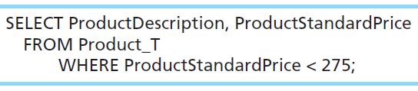
SELECT Example
Find products with standard price less than $275
Comparison operators include
= Equal to
> Greater than
>= Greater than or equal to
< Less than
<= Less than or equal to
<> Not equal to
!= Not equal to
Notes:
The WHERE clause includes one or more conditions. A condition is a test that for each row in the table is either true or false. Only those with true results are permitted in the result set of the query.
SELECT ProductDescription, ProductStandardPrice
FROM Product_T
WHERE ProductStandardPrice < 275;

Slide 32
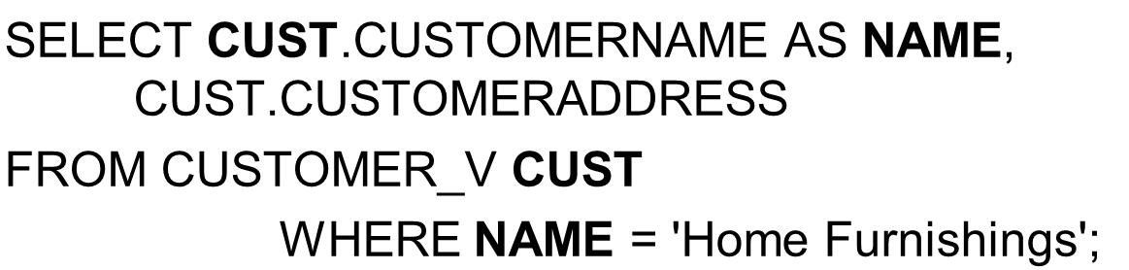
SELECT Example Using Alias
Alias is an alternative column or table name
Notes:
Aliases are useful. They can often save on typing time when writing a query.

Slide 33
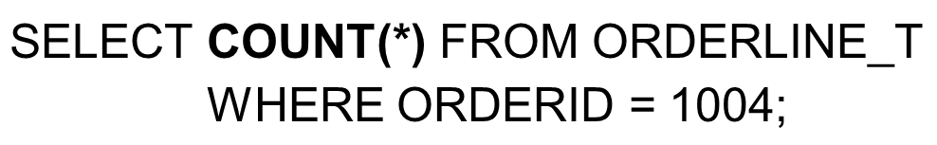
SELECT Example Using a Function
Using the COUNT aggregate function to find totals
Note: With aggregate functions you can’t have single-valued columns included in the SELECT clause, unless they are included in the GROUP BY clause.
Notes:
The most common aggregate functions are COUNT, SUM, and AVERAGE.
What the above query gives is a number indicating the total number of order line records associated with order number 1004.

Slide 34
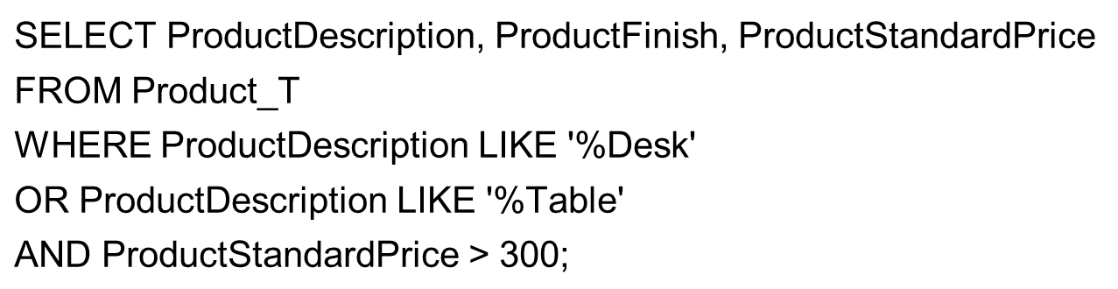
SELECT Example – Boolean Operators
AND, OR, and NOT Operators for customizing conditions in WHERE clause
Notes:
The WHERE clause in this query has tests for three conditions. It lists product name, finish, and standard price for (a) all desks, and (b) all tables that cost more than $300 in the Product table.
Note: The LIKE operator allows you to compare strings using wildcards. For example, the % wildcard in ‘%Desk’ indicates that all strings that have any number of characters preceding the word “Desk” will be allowed.
Note also: The AND logical operator processes before the OR operator.

Slide 35
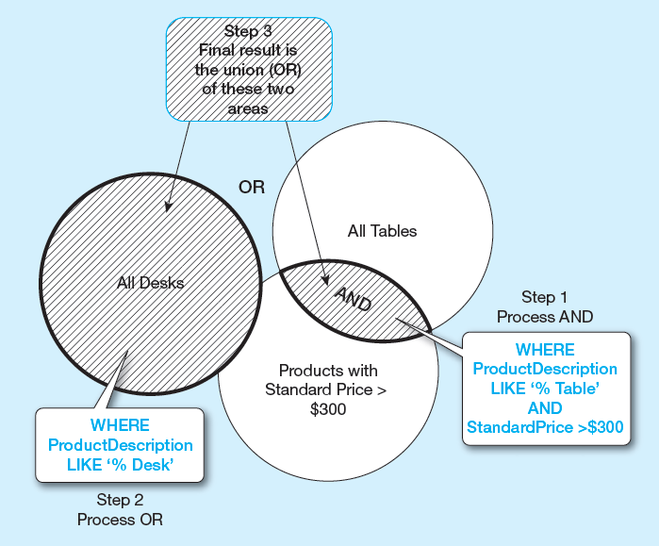
Figure 5-8 Boolean Query a Without Use of Parentheses
By default, processing order of Boolean operators is NOT, then AND, then OR
Notes:
By default, the AND operation takes place before the OR. So, only tables over $300 are included (via the AND). These are then combined with all desks (no matter what price) via the OR.

Slide 36
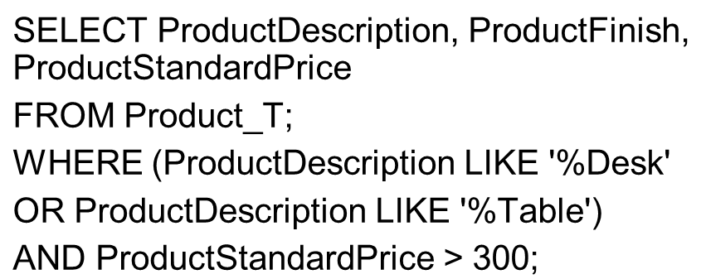
SELECT Example–Boolean Operators
With parentheses…these override the normal precedence of Boolean operators
With parentheses, you can override normal precedence rules. In this case parentheses make the OR take place before the AND.

Slide 37
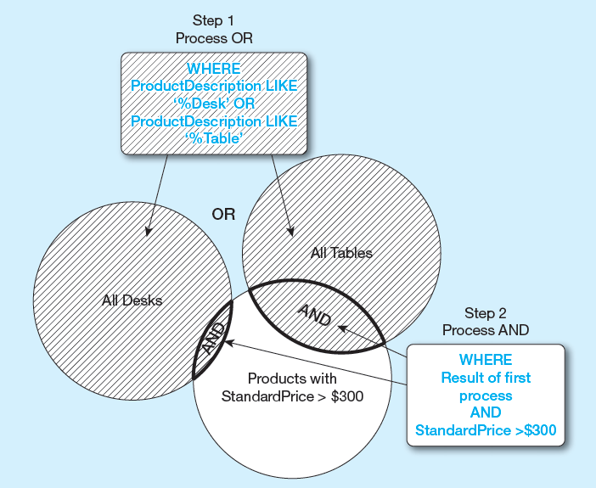
Figure 5-9 Boolean Query B with Use of Parentheses
With parentheses, you can override normal precedence rules. In this case parentheses make the OR take place before the AND.

Slide 38
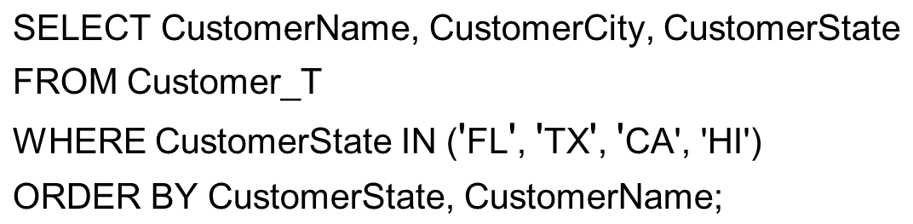
Sorting Results with ORDER BY Clause
Sort the results first by STATE, and within a state by the CUSTOMER NAME
Note: The IN operator in this example allows you to include rows whose CustomerState value is either F L, T X, C A, or H I. It is more efficient than separate OR conditions.
Notes:
You can order by any number of fields from the originating table.
Question: How would you have done the WHERE clause if you used OR conditions instead of the IN operator?
Answer: WHERE CustomerState = ‘FL’ OR CustomerState = ‘TX’ OR CustomerState = ‘CA’ OR CustomerState = ‘HI’

Slide 39
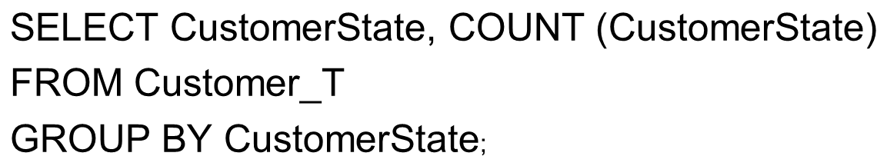
Categorizing Results Using GROUP BY Clause
For use with aggregate functions
Scalar aggregate: single value returned from S Q L query with aggregate function
Vector aggregate: multiple values returned from S Q L query with aggregate function (via GROUP BY)
You can use single-value fields with aggregate functions if they are included in the GROUP BY clause
Notes:
This is an example of vector aggregate. It will return the number of customers from each state. This query will return the name and count of customers from all states that actually have customers.
If all we wanted was the total number of customers (across all states), we could do this scalar aggregate query:
SELECT COUNT(*) from Customer_T
This query will return a single value, which is the total number of customers. That would be the sum of all the individual numbers returned from the aggregate query displayed in this slide.

Slide 40
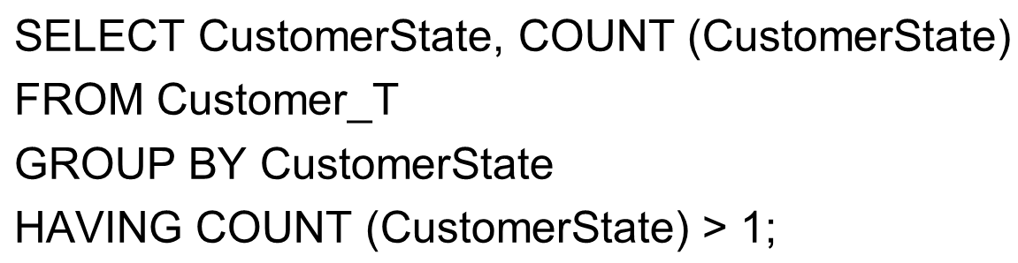
Qualifying Results by Categories Using the HAVING Clause
For use with GROUP BY
Like a WHERE clause, but it operates on groups (categories), not on individual rows. Here, only those groups with total numbers greater than 1 will be included in the final result.
Notes:
The HAVING clause restricts which groups will be returned in a vector aggregate query. It’s like a WHERE clause, but operates on groups, not individual rows.

Slide 41
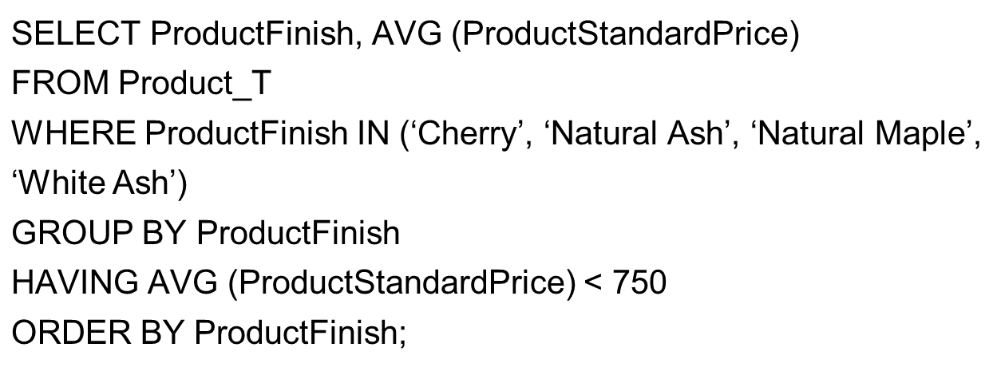
A Query with Both WHERE and HAVING
Notes:
First, the WHERE clause restricts us to only products with certain types of Product Finish. Then, after that they are grouped by the product finish and average prices calculated for each group. Only the groups with average price less than $750 are included in the final result, via the HAVING clause. After all this is done, they are ORDERed alphabetically by ProductFinish.
So, the WHERE clause operated to restrict the number of rows, and then the HAVING clause was used to restrict the number of groups.

Slide 42
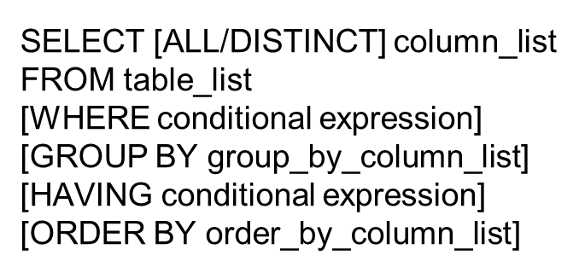
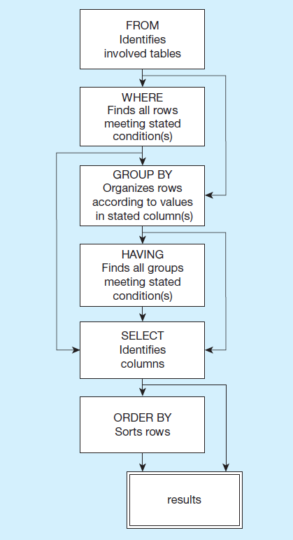
Figure 5-10 S Q L Statement Processing Order
(based on van der Lans, 2006, p. 100)
Notes:
The SELECT clause specifies which columns to return. The FROM clause specifies which tables these come from. The WHERE clause specifies conditions that determine whether a row is returned in the results. GROUP BY and HAVING are used for aggregate queries and ORDER BY determines sorting. Note that queries can also include subqueries, so you may see a SELECT inside another SELECT.

Slide 43

Copyright

